Slide 1
Analyzing the Neighborhoods in Chennai for Starting a Restaurant
By: Anu Rithiga B
Date: May 10, 2021

Slide 2
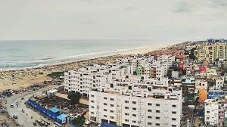
Introduction
Chennai is one of the metropolitan cities of India and is one of the most densely populated cities in the world.
The multi-cultural nature of the city brings with it numerous cuisines from all over the globe
Business owners and entrepreneurs might be looking to start a new restaurant in Chennai
The task is to identify neighborhoods that have the potential of being good locations for starting a new restaurant.
Figure 1: Chennai view

Slide 3
Data Collection
The following data was collected for this project:
Neighborhood data of Chennai from
https://en.wikipedia.org/wiki/List_of_neighbourhoods_of_Chennai
Geographical coordinates of Chennai and all neighborhoods in Chennai using GeoPy and Geocoder libraries in python
Venue data for all neighbourhoods in Chennai using Foursquare API
The data was then cleaned to produce the final datasets shown in the upcoming slides

Slide 4
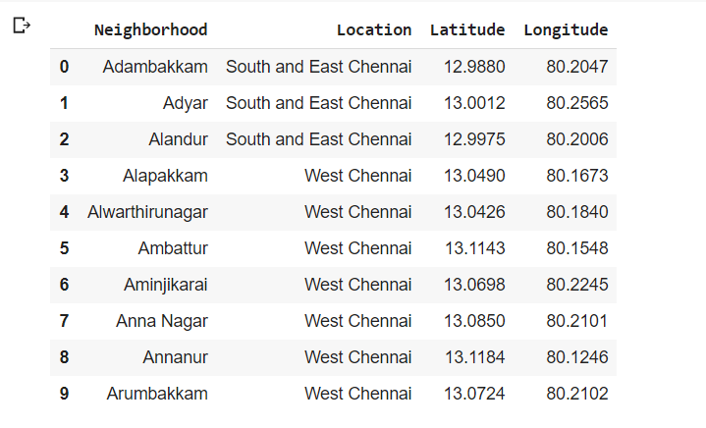
Dataset for Chennai Neighborhoods
Figure 2: First 10 rows of Chennai Neighbourhood Data frame

Slide 5
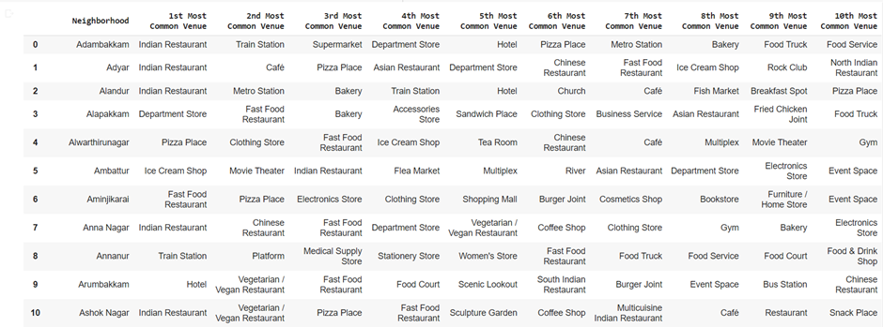
Dataset for Top 10 Most Common Venues
Figure 3: First 10 rows of top 10 most common venues for all neighbourhoods

Slide 6
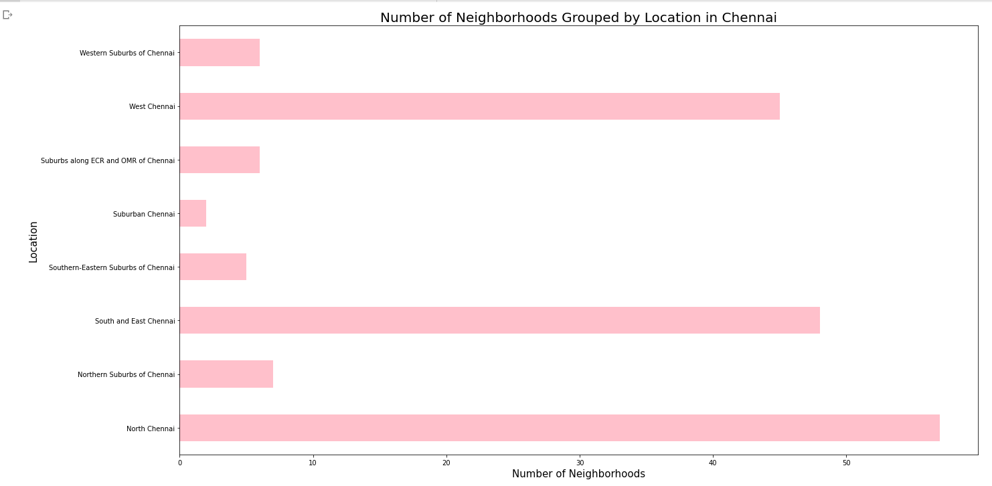
Methodology
Data Visualization
Chennai neighborhoods data was plotted for providing a better understanding
The graph alongside depicts the number of neighborhoods in each location of Chennai
All neighborhoods on the outskirts of the city have been grouped as “Chennai”
South and east Chennai and North Chennai contain the highest number of neighborhoods
Figure 4: Number of neighbourhoods grouped by location

Slide 7
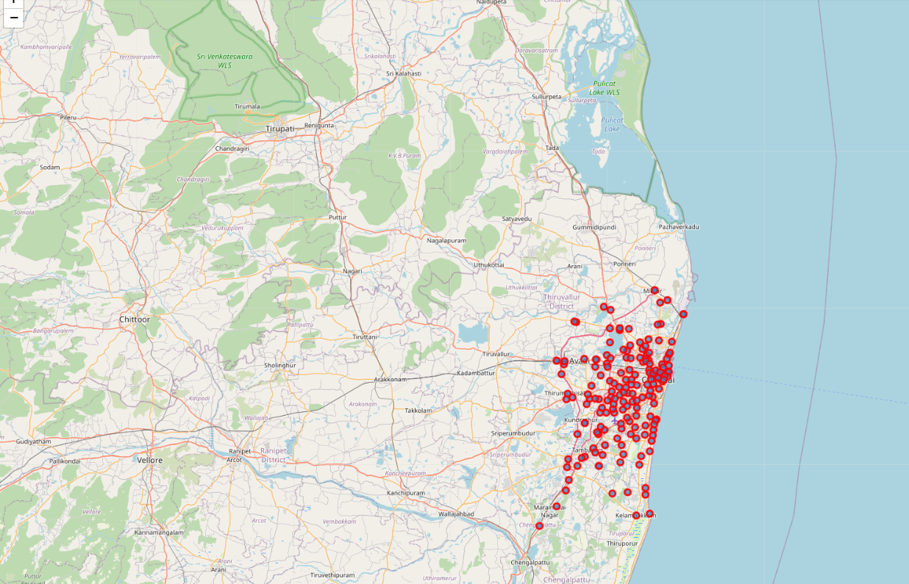
Methodology Continued
Data Visualization
The Folium library in python was used to visualize the spread of all neighborhoods across Chennai
Figure 5: The neighbourhood spread across Chennai

Slide 8
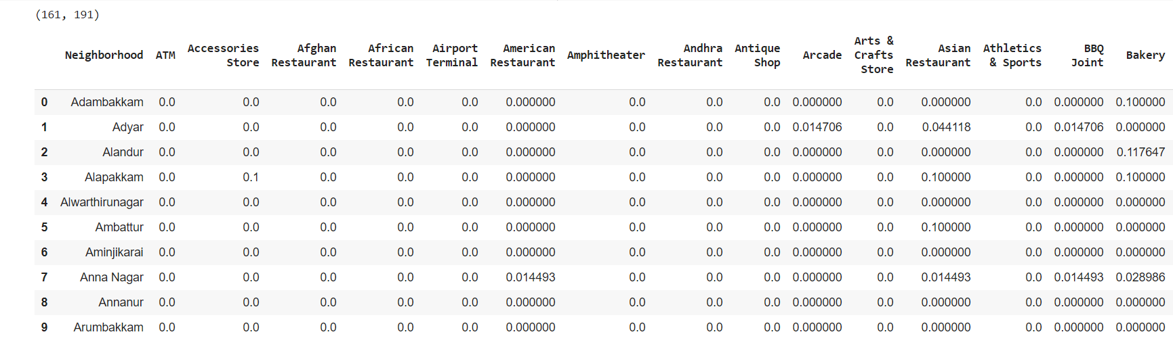
Methodology Continued
One-hot Encoding
One-hot Encoding was used to encode venue categories to numeric values with 1 if a venue belongs to a category and 0 if a venue does not belong to a category for all neighborhoods
The average is then taken for all venue categories in a neighborhood to produce the data frame shown.
Figure 6: One-hot Encoding resulting dataframe

Slide 9
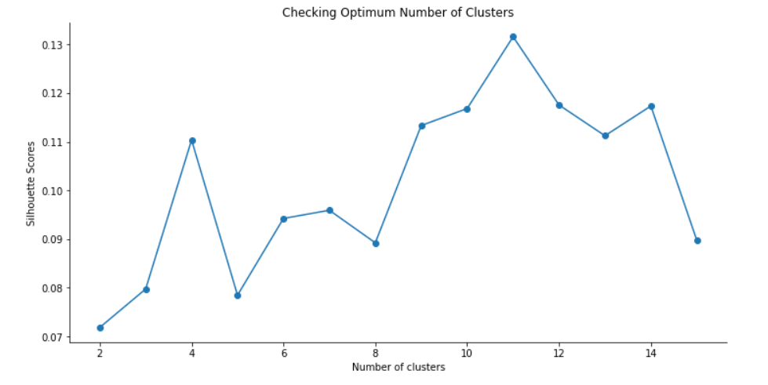
Methodology Continued
Unsupervised Learning Model
K-Means clustering was used to cluster neighborhoods in Chennai based on venue categories
The plot shows a maximum Silhouette Score for 11 clusters and thus the n_clusters parameter in K-Means clustering was set to 11
Figure 7: Silhouette scores for varying number of clusters in K-Means clustering

Slide 10
Results
Each neighborhood received a cluster label based on clustering by the K-Means algorithm
The Cluster Label column along with the Location, Latitude, and Longitude columns were added to the top 10 most common venues data frame to provide the final results
This data frame is shown on the next slide.

Slide 11
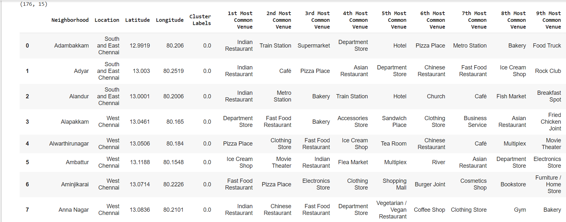
Results Continued
Figure 8: First 10 rows of clustering neighbourhoods in Chennai data frame

Slide 12
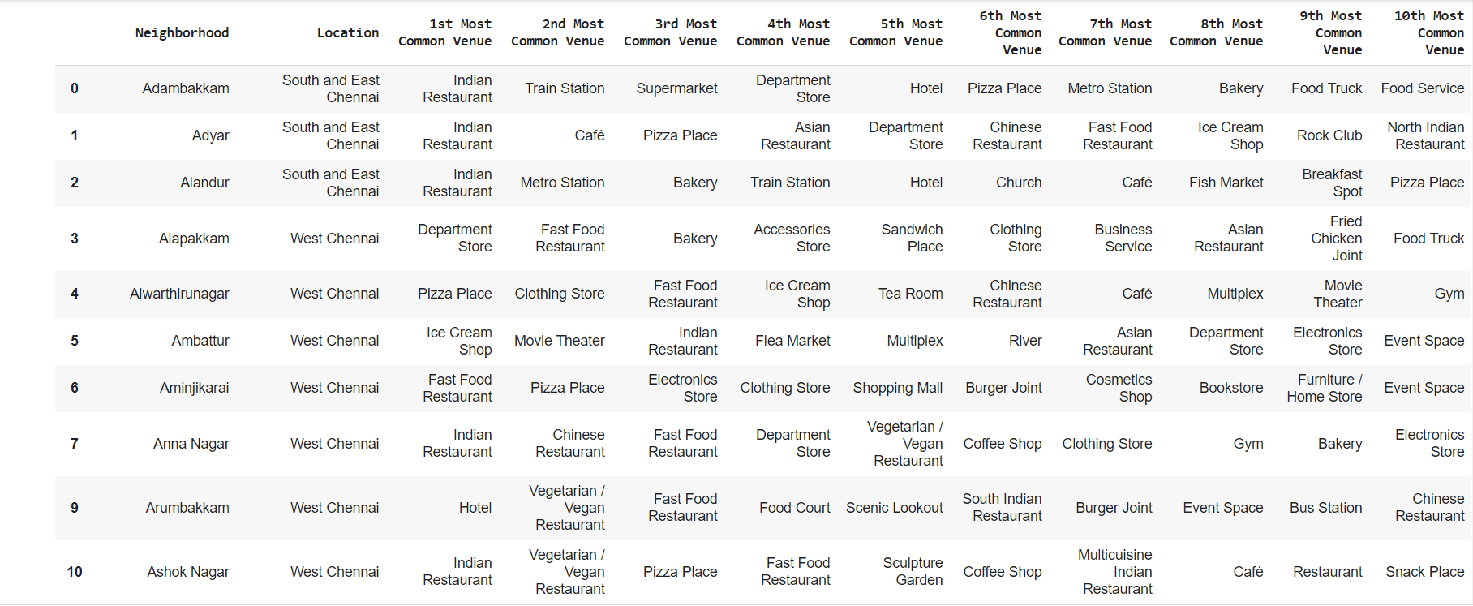
Results Continued – Cluster 1
Analyzing each cluster individually
Figure 9: Cluster 1

Slide 13
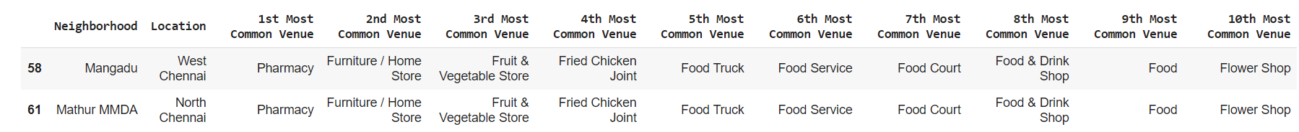
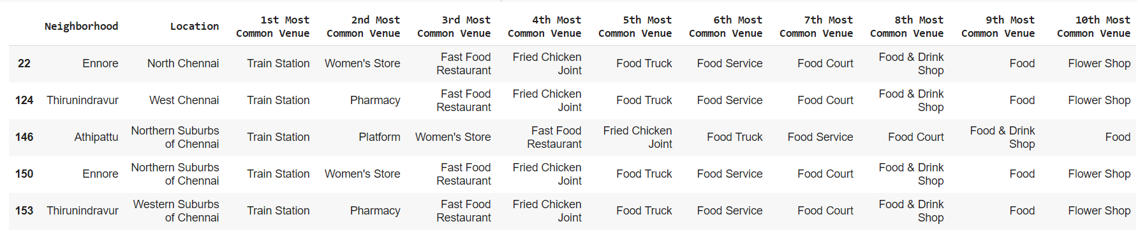
Results Continued – Cluster 2, 3
Figure 10: Cluster 2, 3

Slide 14
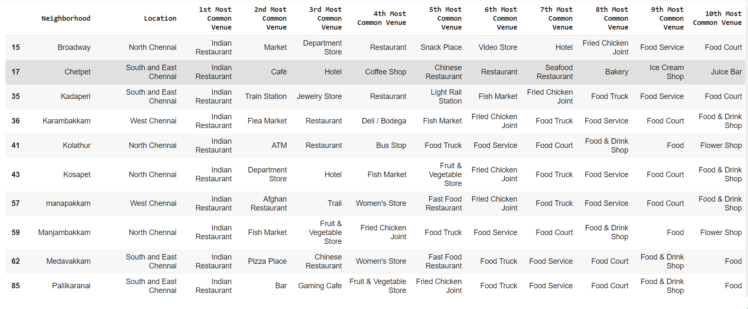
Results Continued – Cluster 4
Figure 11: Cluster 4

Slide 15
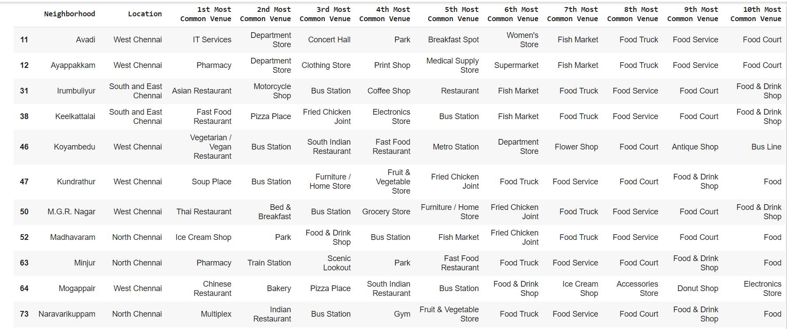
Results Continued – Cluster 5
Figure 12: Cluster 5

Slide 16
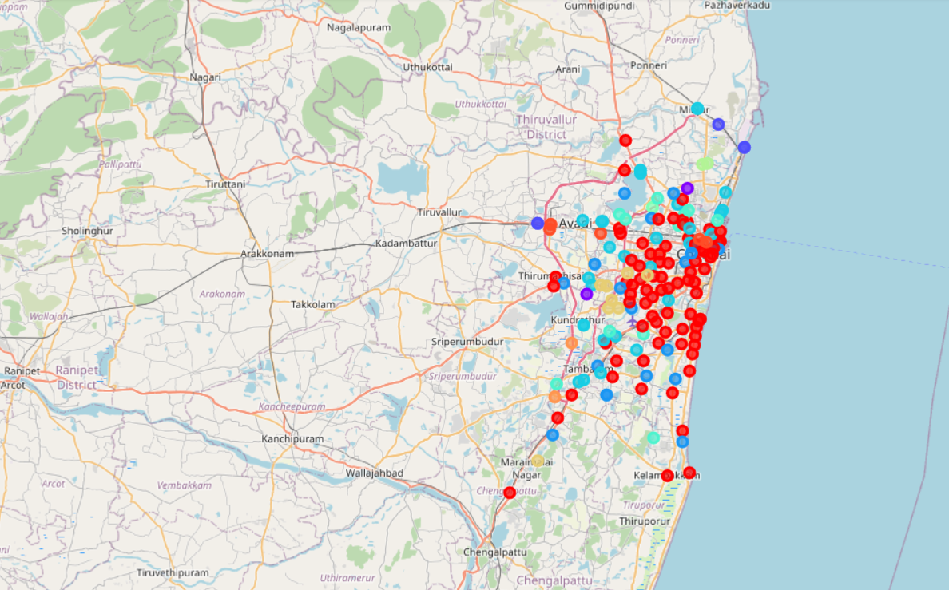
Results Continued
Visualization of neighborhood clusters was done using Folium in python
Different clusters correspond to different colors
Figure 13: Visualizing the clustering of neighbourhoods in Chennai

Slide 17
Discussion
By analyzing the clusters, it is evident that neighborhoods in cluster 2, 3, and 4 are not well suited for a new restaurant since they contain a high degree of other venues like train station, bus station, fish market, gym and smoke shop.
Comparing clusters 1 and 5, we find that neighborhoods in cluster 1 contain a much higher degree of food joints
Neighborhoods in cluster 5 contain many other venues like soccer field, flea market, smoke shop, gym, train station, dance studio and music store
Thus, the most optimal neighborhoods for starting a restaurant are in cluster 1

Slide 18
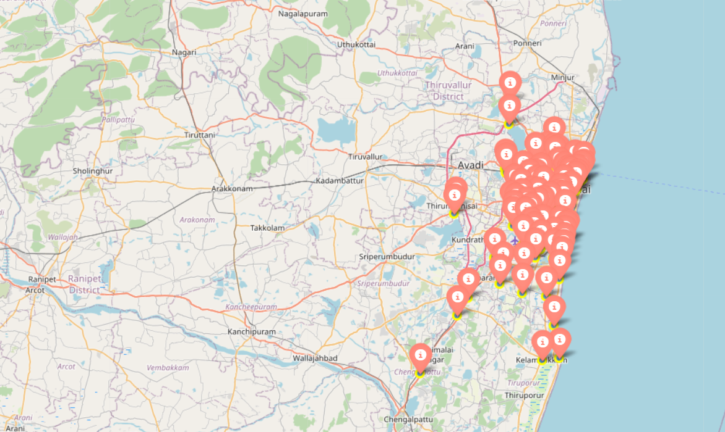
Discussion Continued
Plotting final results using Folium library in python
Figure 14: Neighbourhoods in Chennai that are most suited for starting a new restaurant (Cluster 1)

Slide 19
Conclusion
In this project, the neighbourhoods in Chennai, India have been successfully analysed for determining which would be the best neighbourhoods for opening a new restaurant
Based on the analysis carried out, neighbourhoods in cluster 1 are recommended as locations for the new restaurant
The stakeholders and investors can further tune this by considering various other factors like transport, legal requirements, and costs associated which were out of the scope for this project and thus were not considered

